Slide 1



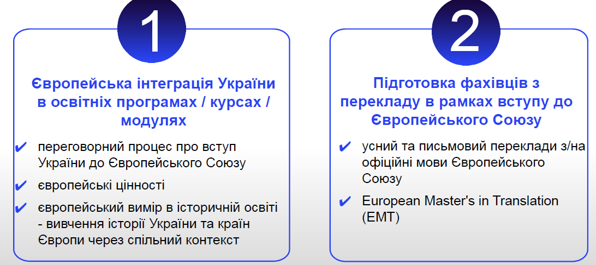
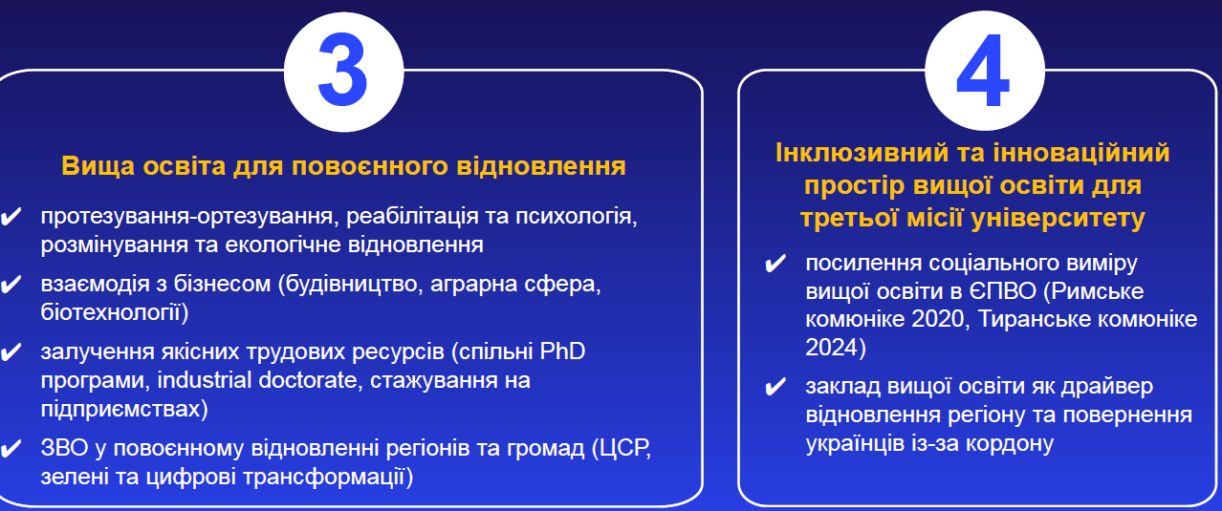
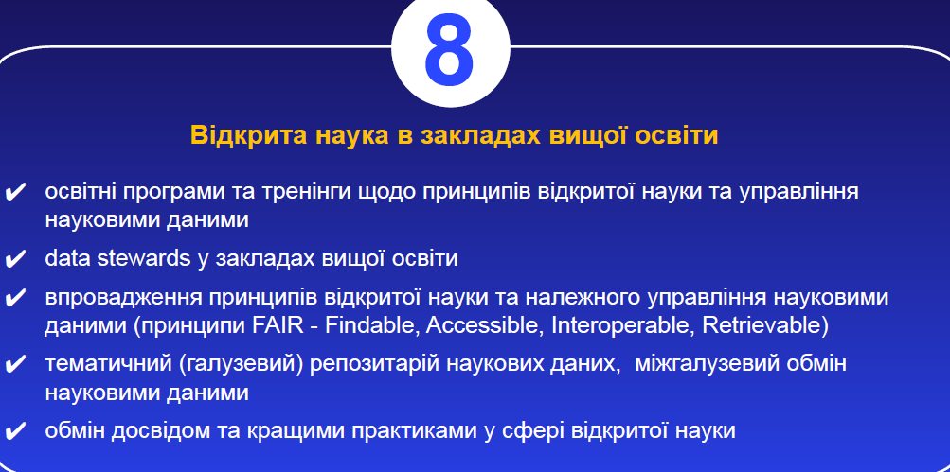
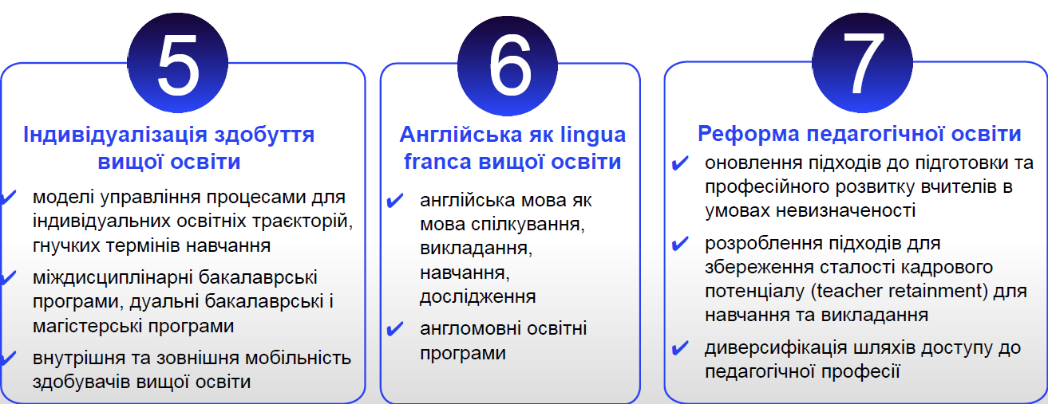
Національні пріоритети для проєктів: за участі МОН України (Strand 3 чи 2 якщо плануєте )

Slide 2
National Priorities for projects recommended by the
Ministry of Education and Science of Ukraine:
European Integration of Ukraine in curricula / courses / modules
Negotiation process on accession of Ukraine to European Union
✔ European Values
✔ European Dimension on education in history – Study of history of Ukraine and EU member states via common context
Education of translators/interpreters for accession to European Union
✔ interpretation and translation from/to official languages of European Union
✔ European Master's in Translation (EMT)
Higher Education for the post-war recovery
✔ prosthesis-orthotics, rehabilitation and psychology, demining and ecological recovery
✔ cooperation with business (construction and architecture, agriculture, biotechnologies)
✔ involvement of high quality human resources (joint PhD programmes, industrial doctorates, job shadow / traineeships at enterprises)
✔ HEIs in post-war recovery of regions and communities (SDG, green and digital transitions)

Slide 3
National Priorities for projects recommended by the
Ministry of Education and Science of Ukraine:
Inclusive and innovative Higher Education area for the 3rd mission of University
✔ strengthening of social dimension of Higher Education in EHEA (Rome Communique 2020, Tirana Communique 2024)
✔ Higher Education Institution as a driver of recovery of region and return of Ukrainians from abroad
Individualisation of Learning Paths in Higher Education
✔ models of manage of processes for individual learning path and flexible periods of study
✔ interdisciplinary Bachelor programmes, Dual Bachelor and Master programmes
✔ national / internal and international mobility of students
English as a lingua
Franca of higher education
✔ English language as means for communication, teaching, learning, research
✔ Study Programmes developed in English language
Рedagogical (Teachers) Education Reform
✔ modernisation of approaches to the education and professional development of teachers under uncertainty
✔ development of approaches to support for sustainability of human resources (teacher retainment) for learning and teaching
✔ diversification of ways for access to teacher’s profession

Slide 4
National Priorities for projects recommended by the
Ministry of Education and Science of Ukraine:
Open Science in Higher Education Institutions
✔ study programmes and trainings on the Open Science principles and science data management
✔ data stewards at the Higher Education Institutions
✔ implementation of the Open Science principles and good management of scientific data (FAIR principles – Findable, Accessible, Interoperable, Retrievable)
✔ thematic (sectoral) science data repository, intersectoral exchange of scientific data
✔ exchange of experience of best practices in the Open Science sphere
Неофіційний переклад від НЕО в Україні
Першоджерело: презентація МОН України
Офіційний лист з пріоритетами та процедурою попереднього відбору проєктів де плануєте залучати МОН України надійде згодом до ЗВО України

