Slide 1
European trend and practice of the building the student's individual educational trajectory
Horia-Șerban Onița, TAM expert
19th of December 2024

Slide 2
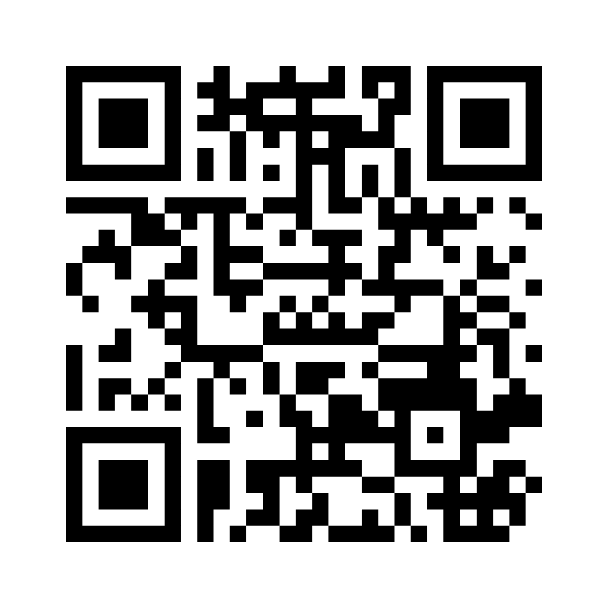
Go to Menti.com → 1505 8677

Slide 3
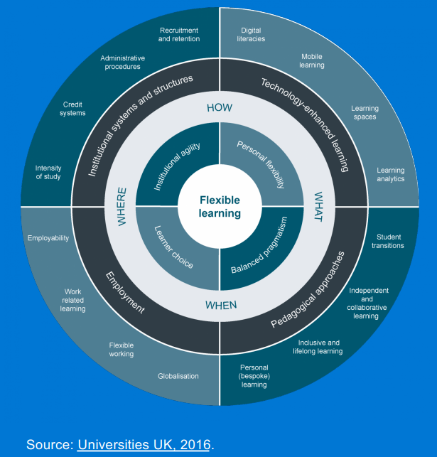
Flexible learning – definition and rationale
Flexible Learning = learning process free from the constraints of time, place, and pace, where a learner can choose entry and exit points, learning activities, assessment modes, and educational resources (Naidu, 2017)
Flexible Learning Pathways = Entry points and re-entry points at all ages and all educational levels , strengthened links between formal and non-formal structures and recognition, validation and accreditation of the knowledge, skills and competencies acquired through non-formal and informal education (UNESCO, 2015)

Slide 4
Student-centred learning – underpinnings and drivers
Flexible learning pathways are part of a more complex, multi-layered paradigm: student-centred learning
Student-centred learning includes a shift of pedagogy (first layer), learning environment (second layer) and institutional culture/approach (third layer), based on the distinctions proposed by Klemencic → it is not only policy-driven, but also politics-driven.
SCL has been derived from pedagogical sciences, with the gain of popularity of constructivism based on the learning theories of Piaget.
The drivers (which also can help identify the scope):
Massification - a more diverse student population also implies more diverse demands
More adults (needs for reskilling and upskilling)
Shifting labour market - learning to learn, adaptability, transversal skills
More focus on active citizenship
Shifting patterns of learning due to exogenous environment
Enhancing the resilience of education systems
Notes:
Evolved vertically, horizontally and in scope

Slide 5

SCL as an umbrella term encompassing FLP
SCL never defined in the Bologna Process, but from 2007 to 2015 evolving indirect definition by approximating its content:
2007 London Communique: not a commitment, but an effect of BP policies (KC but not only): ‘a significant outcome of the process will be a move towards SCL’.
2009 Leuven Communique: SCL linked with both labour market and empowering students to become active and responsible citizens. Holistic view of SCL, not only a pedagogical concept + first link with learning outcomes
2010 Budapest-Vienna Communique: focus on learning and working environment
2012 Bucharest Communique: adding innovative teaching methods and student participation as precondition
2015 Yerevan Communique: including digitalisation, assessment methods, curriculum design + ESGs
Lack of explicit definition: risk of ‘anything goes’, but SCL has an internal coherence
Rome 2020 Communique + Annex II: reiteration and collection of previous commitments + micro-credentials, open education, and learning analytics, as well as more clearly enforcing the link between SCL and social dimension
Notes:
Evolved vertically, horizontally and in scope

Slide 6
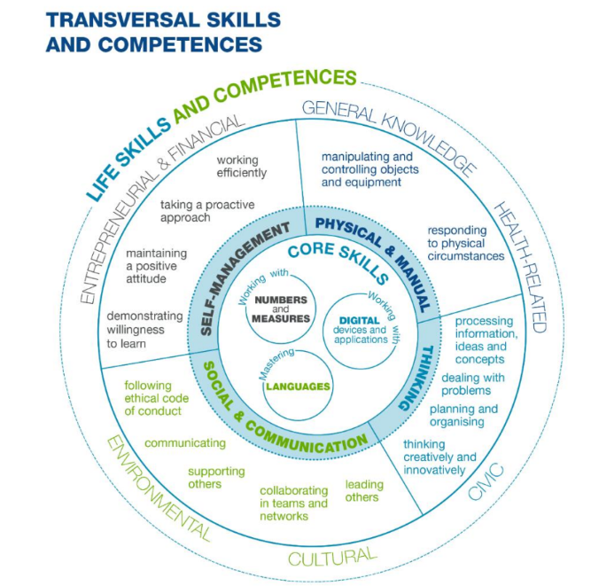
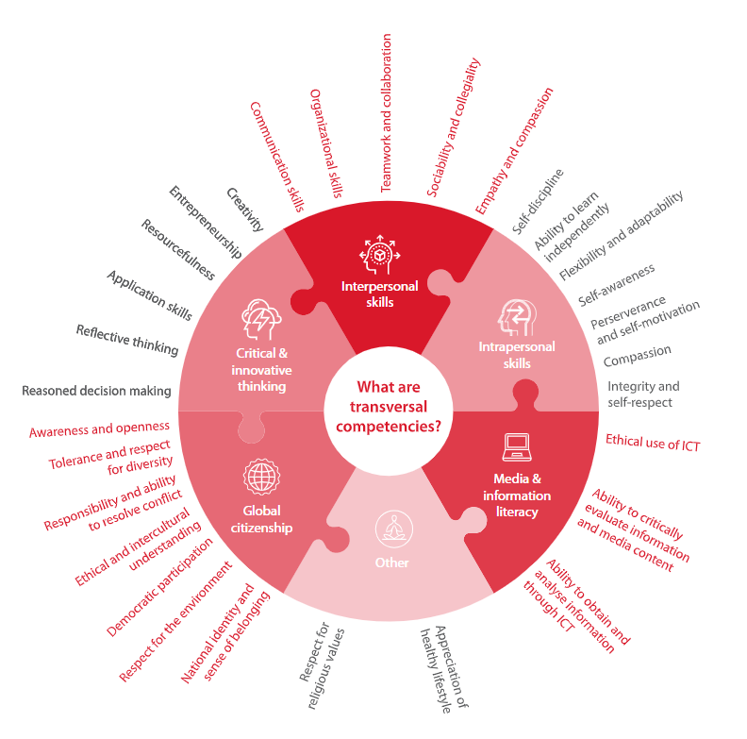
SCL concept from student eyes
ESU definition 2015: ‘both a mindset and a culture […] characterised by innovative methods of teaching which aim to promote learning in communication with teachers and other learners and which take students seriously as active participants in their own learning, fostering transferable skills such as problem-solving, critical thinking and reflective thinking’

Slide 7
Basis for SCL: Bologna tools
Qualification Frameworks (QF-EHEA, EQF): designing learning outcomes, RPL
Learning outcomes: usage of learning outcomes in teaching and assessment, ECTS as a common currency
European Standards and Guidelines for QA: twofold role: standard on SCL and student participation in QA

Slide 8
SCL as an institutional endeavour
According to the European University Association (EUA) Trends 2018 report, 80% of HEIs surveyed across the European Higher Education Area (EHEA) see a need for more flexible provision for degree programmes
Approaches for SCL:
From student satisfaction (consumerism) to student engagement and to student agency
Articulation of learning paths (Haas, 1999)
Institutional approaches for in-programme, between-programme and between-institutions flexibility
  In-programme: Schedules and course delivery, assignment, programme duration, permeability, modes of learning, electives
Recognition of prior learning (according to Council Recommendation on VNFIL and CEDEFOP Guidelines)
Initial and continuous teacher training, evaluation, appraisal and promotion criteria (including right to err)
Stronger data collection on experiences and impact on learning (path)
Flexible units – needs for coherence and completeness, avoid false promises of panacea
Research in teaching and scholarship of teaching and learning (SOTL)
Specific policy/institutional declaration on SCL/Flexible learning pathways

Slide 9
SCL as an institutional endeavour - examples
Systemic approaches: 2004 Flexible Learning Paths Act, Belgium-Flemish Community - degree contract, a credit contract, or an examination contract.
Recognition of prior learning:
policies: Scotland (HEIs as Credit Rating Bodies) and Korea (Academic Credit Bank System)
percentages: Italy – 12 ECTS, Germany, Switzerland, Poland – 50%, Hungary – 66%, Lithuania – 75%, Norway – at least 60 ECTS not recognised
Articulation: Finland – Flexible Study Rights Agreements (horizontal). Articulation can also be vertical.
Funding: Finland, 5% of funding for credits earned for continuing learning and 1% based on cross-study credits at other HEIs
Specialisation: UK - major and minor system
University of Barcelona – offers MOOC programmes with internal recognition rules
Dublin Institute of Technology – SCL-adapted part-time programme focused on the existing skills – reduced dropout rate.
Utrecht University - an online course called ‘PreScriptum’ enables students to create individual learning pathways.

Slide 10
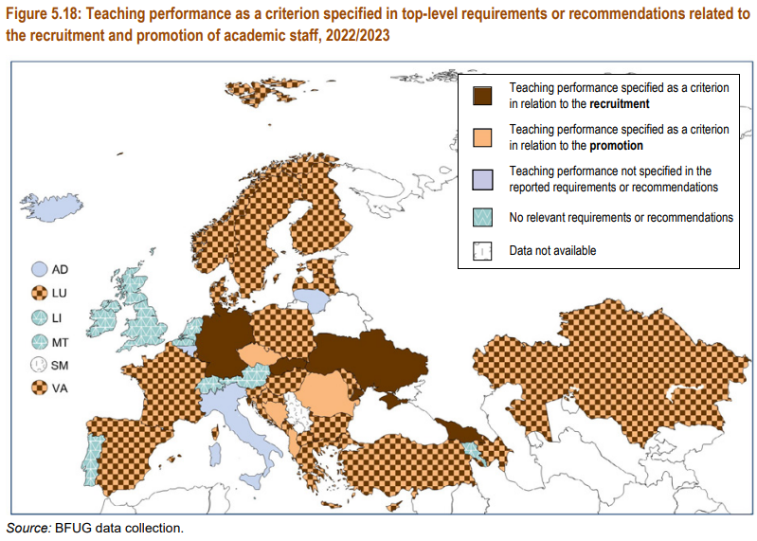
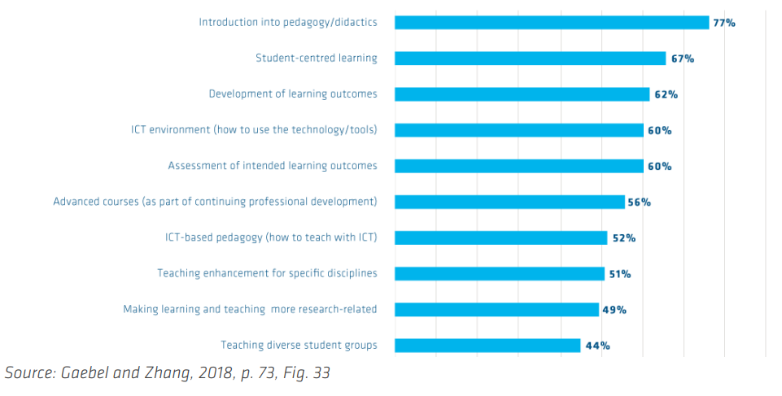
SCL as an institutional endeavour - examples

Slide 11
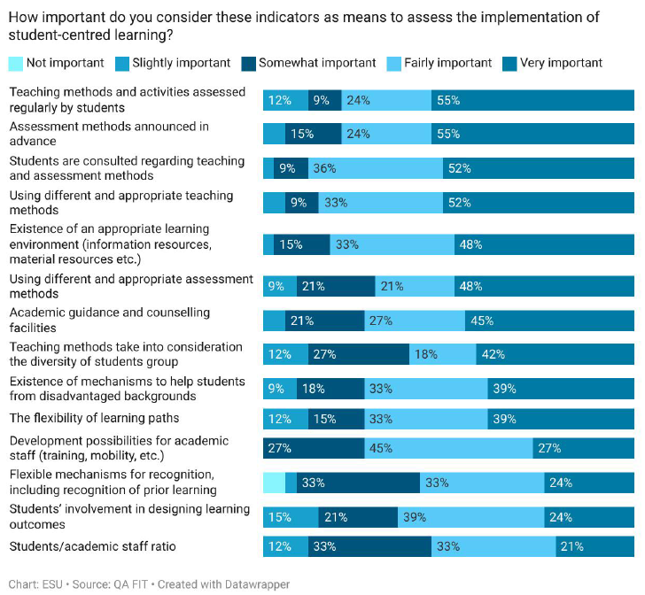
Role of quality (assurance)
Define what quality is (Harvey and Green: exceptional, consistent, fit for purpose, value for money, transformative learning process)
Quality as purposeful, transformative, exceptional and accountable (Schindler)
Excellence in teaching: actor, action, outcome, process, resources
Changes are systemic and there is follow-up
Student participation – legitimation, belonging
Different type of SCL materialisation based on indicators
(output vs process) -> choice matters!

Slide 12
SCL as an learning environment
Up-to-date educational resources, including (online) libraries and quality educational infrastructure
Information, guidance, counselling, tutoring/mentoring systems – paradox of choices
Student support services
The Role of Libraries and Information Systems
Challenges for students: The challenges of flexible learning for students lie mostly with time management and scheduling, self-motivation and discipline
Example: University of Essex has designed a student-centred personalised engagement tool, the Learner Engagement Activity Portal (LEAP), produces an overall engagement indicator

Slide 13
SCL as pedagogy
SCL is a whole-change approach focused on moving from mnemonic to learning-outcomes based
Learning and teaching methods – putting students in the ‘driver seat’, flexibility of approaches, diverse range of methods and (digital) tools and exercises
SCL does not imply ‘one size fits all’, neither in intensity (more traditional for foundational courses) or in reception – students need to be prepared to use SCL
Fostering a wide range of transversal skills
Difference between personalised education (choice of contents) and individualised education (choosing the pace)
Timely feedback, including post-assessment
Klemencic (2019): active learning practices, collaborative learning activities, experiential learning (inquiry based, problem-based), self-regulated learning
Each study programme and discipline should have its own SCL - course catalogs

Slide 14
Key considerations
SCL: Structural or cultural?
People-oriented or process-oriented (Roffe)?
Learn ‘A lot about a little’ or ‘A little about a lot’?
You cannot be flexible with everything – choose! (involving stakeholders)
Do not send mixed messages about SCL
Assessment does the signalling for students and counselling determines the arena of choices
Teacher assessment, appraisal and incentives does the signalling for staff
The core principles of SCL remain the same, but new forces and developments (student learning patterns, digitalisation, international connectedness etc) influence HE policy on SCL
Self-assesment tools: UNESCO, European Commission

Slide 15
European trend and practice of the building the student's individual educational trajectory
Horia-Șerban Onița, TAM expert
19th of December 2024

