Slide 1
Development/design of curriculum using digital tools for providing an inclusive educational process
Horia-Șerban Onița, TAM expert
19th of December 2024

Slide 2
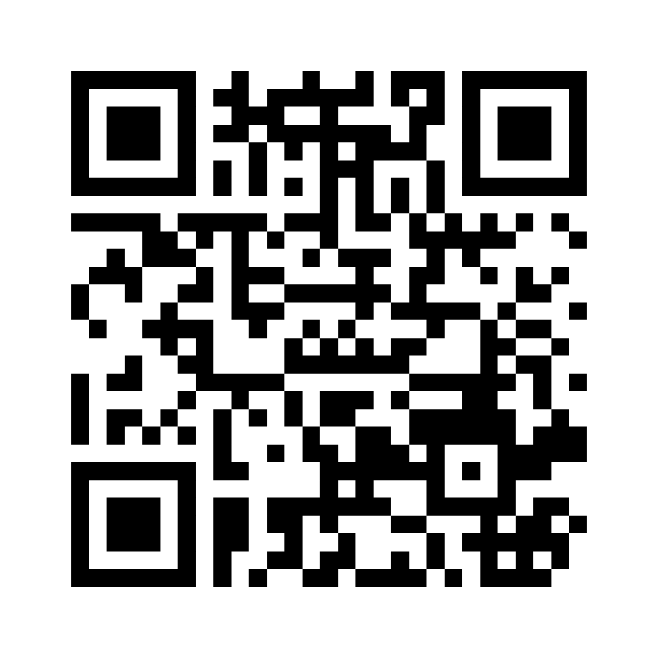
Go to Menti.com → 1505 8677

Slide 3
Bologna Process views
Social Dimension has become one of the core components of BP, based on the commitment taken in the 2007 London Communique that the composition of the student body entering, progressing in and completing higher education should be representative of the population at large
In 2020 the Ministers adopted the Principles and Guidelines for Strengthening the Social Dimension of Higher Education in EHEA, while in 2024 they adopted Indicators and Descriptors for the Principles of Social Dimension in EHEA
None of these documents refer to inclusive access to digital education, albeit they talk about online/blended mobility
Nevertheless, Ministers committed in the Communiques to:
“ensuring accessible student support services, inclusive learning environments (including digital ones), gender equality, as well as measures to support students in covering indirect costs of study” (Tirana Communique 2024)
“reinforcing social inclusion and enhancing quality education, using fully the new opportunities provided by digitalisation” (Rome Communique 2020)
“recognizing that digitalisation does not offer ‘one size fits all’ solutions, and ask the BFUG to propose ways in which all learners can benefit from the new technologies” (Rome Communique 2020)
“supporting our higher education institutions in using digital technologies for learning, teaching and assessment, as well as for academic communication and research, and to investing in the development of digital skills and competences for all” (Rome Communique 2020))
Notes:
Evolved vertically, horizontally and in scope

Slide 4
European Union work
Digital Education Action Plan 2021-2027
European Digital Education Content Framework
European Digital Competence Framework
European Digital Skills Certificate (EDSC)
Council Recommendation on improving the provision of digital skills in education and training
Council Recommendation on the key enabling factors for successful digital education and training:
  supporting the development and testing of digital educational tools and technologies, as well as research on the quality, inclusiveness, accessibility and impact of digital education solutions, including those based on emerging technologies such as artificial intelligence, immersive technologies such as virtual reality, augmented reality, eXtended Reality, robotics, the metaverse and open source alternatives for digital educational tools
  reflecting the need for digital well-being in the teaching and learning process and the design of supportive digital teaching and learning approaches and environments
Notes:
Evolved vertically, horizontally and in scope

Slide 5
European Union work
Council Recommendation on the key enabling factors for successful digital education and training:
  developing accessible, scalable, adaptable, and high-quality digital education content which is in line with the curricula and good pedagogical practices and digitising teaching and learning materials, when of added value;
  deploying and integrating relevant centralised services, including through cloud solutions, such as virtual learning and administration management systems (including secure communication and collaboration tools, education content repositories, classroom management and digital assessments), in all education and training institutions, while ensuring their standardisation and interoperability, privacy and data security;
  promoting inclusive education by safeguarding the accessibility of digital education content and technologies for learners and teachers with disabilities and providing specialised equipment and solutions for learners with special educational needs, taking into account existing Union accessibility legislation, in particular Directives (EU) 2016/2102 ( 25) and (EU) 2019/882
Notes:
Evolved vertically, horizontally and in scope

Slide 6
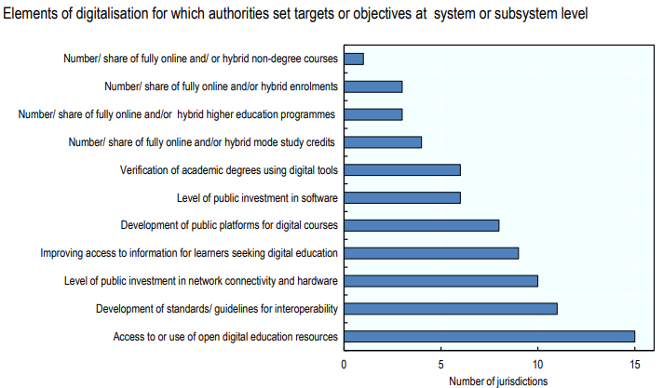
Countries are speeding efforts (OECD)
Notes:
Evolved vertically, horizontally and in scope

Slide 7
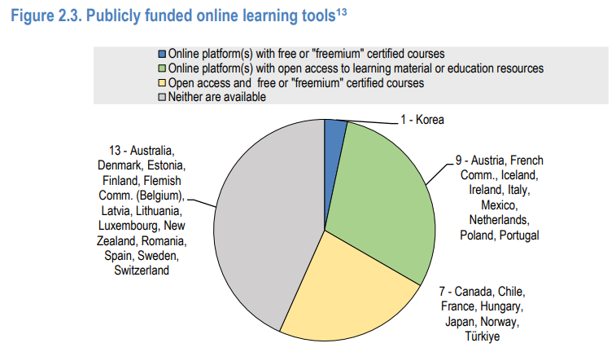
Countries are speeding efforts (OECD)
Notes:
Evolved vertically, horizontally and in scope

Slide 8
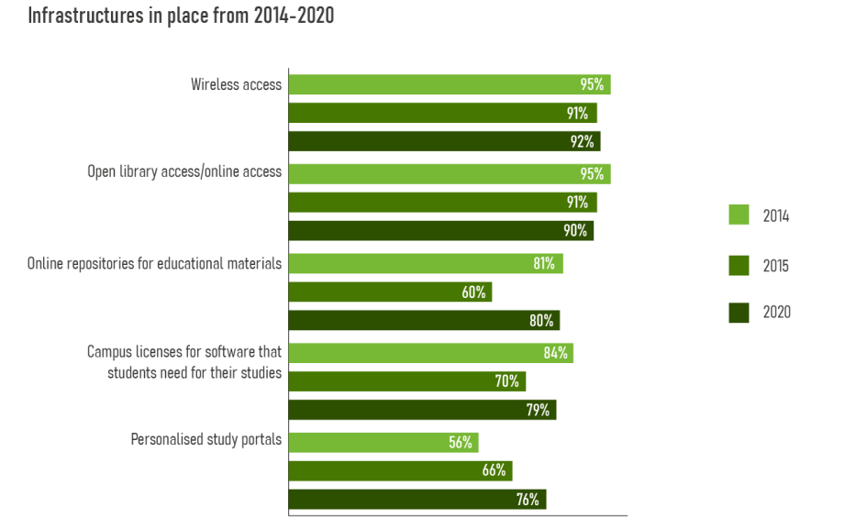
While HEIs already had a start (EUA)
Notes:
Evolved vertically, horizontally and in scope

Slide 9
But ensuring inclusivity of digital tools is not that easy
Simply transforming traditional materials into electronic or digital resources does not directly address diversity; instead, it simply transfers the barriers associated with traditional print materials to the online learning environment (McGhie-Richmond & Howrey, 2014)
Notes:
Evolved vertically, horizontally and in scope

Slide 10
Formal standards for inclusivity are in place
ISO 9241-171:2008 ‘Ergonomics of human-system interaction — Part 171: Guidance on software accessibility’, which focuses on interactive systems and on promoting increased usability of systems for a wider range of users (International Organization for Standardization, 2008).
ISO 9241-20:2021 ‘Ergonomics of human-system interaction — Part 20: An ergonomic approach to accessibility within the ISO 9241 series’, which provides guidelines to improve the accessibility of ICT equipment and services for people with a wide range of sensory, physical and cognitive abilities, including those who are temporarily disabled, and the elderly (International Organization for Standardization, 2021).
But they are too far from specific HE contexts
Notes:
Evolved vertically, horizontally and in scope

Slide 11
Universal design
The original seven principles of "Universal Design" are the following (National Disability Authority. Centre for Excellence in Universal Design, 2020):
  Equitable Use
  Flexibility in Use
  Simple and Intuitive Use
  Perceptible Information
  Tolerance for Error
  Low Physical Effort
  Size and Space for Approach and Use
On the other side, the Web Content Accessibility Guidelines (WCAG) are organized by four main principles: Perceivable, Operable, Understandable, and Robust.
Notes:
Evolved vertically, horizontally and in scope

Slide 12
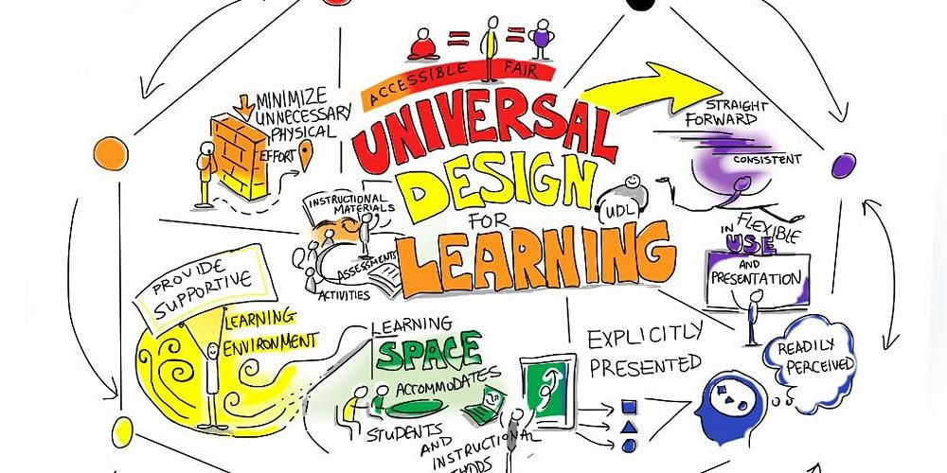
Universal Design for Learning
© Dublin City University
Notes:
Evolved vertically, horizontally and in scope

Slide 13
Universal Design for Learning
UDL was developed in the 1990s and early 2000s by the Center for Applied Special Technology (CAST)
A central premise of UDL is that “the curriculum, rather than the learner, needs to change” (Meyer & Rose, 2005)
The principles of UDL are the following:
1. Engagement
Engagement can be understood as accessibility, by using various media types, video, audio, or digital images. On the other hand, content should be perceivable (e.g. using large print, braille, speech, symbols, or simpler language)
2. Representation
For example through offering options for audio-visual content (transcripts and captions) as well as written content (audio-visual and auditory options)
3. Action and expression
Despite their similarity, UDL does not equate with digital accessibility. While the former are universalistic principles, the latter specifically protect students with sensory, physical, and/or cognitive impairments
Notes:
Evolved vertically, horizontally and in scope

Slide 14
Universal Design for Learning
The provider of the UDL concept, CAST, offers on their website particularisation of information on UDL's three principles, nine guidelines, and 31 checkpoints
The implementation of UDL has been crafted as a Design Cycle (Rao & Meo, 2016), a step-by-step process considering: learner variability, goals, assessments, methods and materials, lessons, revision
Learner variability factors include Abilities and strengths, support needs, backgrounds and experiences, preferences and interests.
Notes:
Evolved vertically, horizontally and in scope

Slide 15
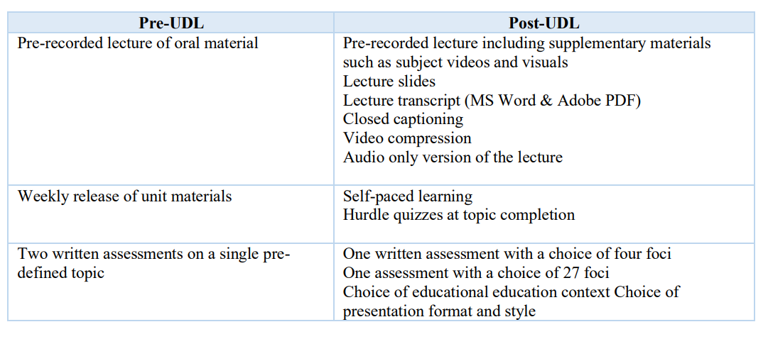
Research shows benefits
© Traci-Ann Garrad and Huw Nolan, The University of New England, Australia, 2023
Their study shown statistically relevant increase in the student satisfaction and their perception of accessibility.
Notes:
Evolved vertically, horizontally and in scope

Slide 16
Various other tools
Various other tools are in place, supporting academic staff:
BOIA platform:
Accessibility testing for the impact of visual disabilities
Accessibility testing for the impact of auditory disabilities
Accessibility testing for the impact of cognitive, learning, and neurological disabilities
Accessibility testing for the impact of physical disabilities
Accessibility testing for the impact of speech disabilities
Oxford University self-evaluation tool
Repository of Accessible Digital Tools and Resources by InclUDE project
InclUDE Technical Guidelines for Accessible Digital Higher Education
Notes:
Evolved vertically, horizontally and in scope

Slide 17
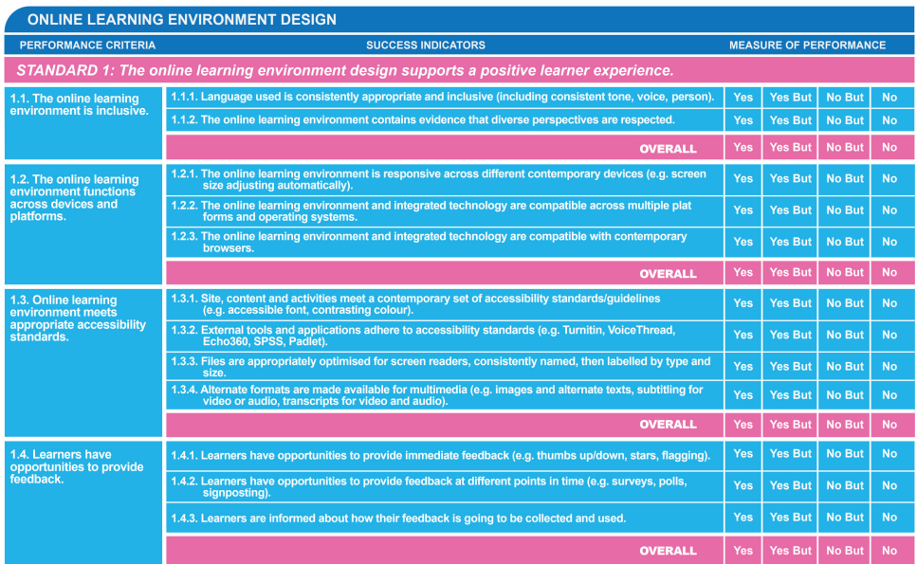
TELAS self-assessment framework
Notes:
Evolved vertically, horizontally and in scope

Slide 18
Some practical suggestions
Consider the impact of each type of digital tool: hardware, software (including extensions), technology-based environments (content management systems)
Use ‘hyperdocs’ where all relevant information and resources are collected and hyperlinked
Use a mix of synchronous and asynchronous engagements
Use digital graphic organisers (e.g. Lucid Chart, MindMup), collaborative working/feedback loop apps (Padlet)
Use sans serif fonts
Suggest using machine learning and natural language processing
Send materials before the courses
If recorder beforehand, do not upload videos longer than 20 minutes
Establish clear procedures for students to contact university IT departments
Notes:
Evolved vertically, horizontally and in scope

Slide 19
Examples
Universidad Nacional de Educación a Distancia (UNED) (Spain) courses and online materials for student assessment via digital means
Notes:
Evolved vertically, horizontally and in scope

Slide 20
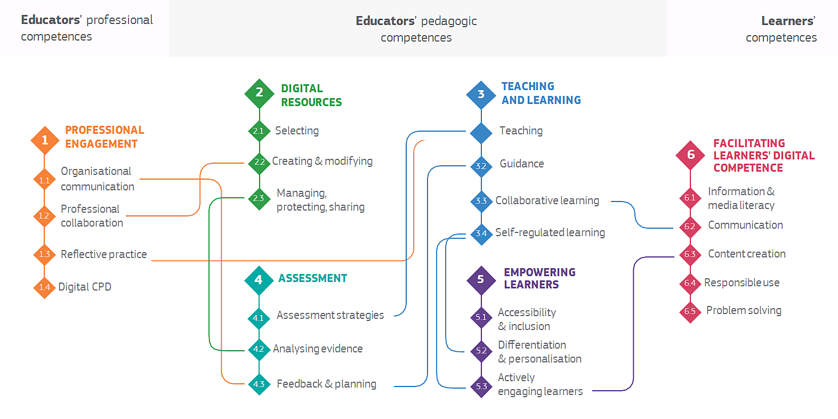
European Framework for the Digital Competence of Educators (DigCompEdu)
Notes:
Evolved vertically, horizontally and in scope

Slide 21
Policy-level suggestions
Adopt a pedagogical approach towards digitalisation backed by funding for the relevant digital tools
Use various sources of data to evidence pedagogical development in digital formats through a trial-and-error mechanism
Agree on a common number of used tools across the entire HEI
Determine if digital skills needed for the courses are only generic and instrumental (learning with), compound to digital literacy (learning about) or require specific digital skills for the field (including if they are only instrumental)
Look into engagement strategies such as gamification
Assess the added value of new digital tools, including whether it amounts to innovation or not
Focus on the choice of assessment, increase summative assessments and design clear guidelines for students
Consider whole-approach self-assessment tools or benchmarks (HE-Innovate, E-xcellence: Quality Benchmarking for Blended and Online Education etc – see EUA’s DigiHE report)
Students falling behind because of the lack of digital skills or because they couldn’t adapt their learning style should be supported through remedial activities
Foster a collaborative platform for staff to share their experiences with using various digital tools
Promote standardisation of LOs from using digital tools
Integrate the deployment of digital tools in regular QA processes
Notes:
Evolved vertically, horizontally and in scope

Slide 22
Development/design of curriculum using digital tools for providing an inclusive educational process
Horia-Șerban Onița, TAM expert
19th of December 2024

